Slide 1
Maple Class Transfer Evening

Slide 2
About us
Mr Dowe
Has been teaching at Milton Ernest for 19 years. Specialist in PE, Science and phonics.
Miss Lucas
Has worked with Mr Dowe for over 20 years. Completes all the admin e.g. book changes and creates all the lovely displays.

Slide 3
Transfer information – A change in how the children learn
Reception- Learning through play with some structured learning e.g. Maths and Read Write Inc
Year 1 – Following the subjects of the National Curriculum. Lots of structured learning with some learning through play. The timetable on the next page details the lessons the children will be doing.

Slide 4
Sample Timetable

Slide 5
Numeracy
Taught practically through the use of Numicon and other resources.
Building on what they have learnt in Foundation stage.
Children will learn about number and place value, addition, subtraction, making and dividing groups, fractions, shape, measuring and time

Slide 6
Numeracy targets We will be working towards the children achieving these by the end of year 1

Slide 7
Read Write Inc
We Focus on learning all the sounds in set 2 and 3 of Read Write Inc (digraphs, trigraphs and split digraphs)
We work on using the sounds to blend with fluency and read words
We also work on recognising words on sight (red words)
We aim for the children to Read with fluency
We complete comprehension activities to develop their understanding of the text and the skills needed to find answers
We build sentences and work on sentence construction and writing complete sentences with no words missing.
We develop spelling, grammar and punctuation
We work on handwriting so the children form all the letters correctly and make them the correct size
The Teachers will hear the children read in RWI lessons 3 times a week. The book that is sent home is for the children to read to their parent to consolidate and practise the learning.
There will be a RWI evening for parents to help support learning at home. There are videos available on You tube as well.

Slide 8
Spelling, punctuation and grammar targets for year 1

Slide 9
Topics
Every term we teach a topic. These cover geography, history, art and technology.
These are engaging, practical and connect learning together

Slide 10
Other Lessons
PE – We teach multi skills (balance, agility, coordination), gym, games and dance
PE days are Monday and Tuesday. The children come to school in PE kit
Science
Music
ICT
RE
Cookery
Personal, social, health and emotional education (PSHE)
Forest School – 6 weeks in the Autumn term

Slide 11
Resilience, mindfulness, activity and Growth Mindset
In addition to the traditional lessons we are also cover:
Mindfulness – Teaching children breathing techniques to relax, focus and calm down
Activity – The children complete morning workouts, skipping sessions and daily runs to achieve their 1 hour a day of activity
Resilience and growth mindset lessons to help children accept mistakes as part of learning and develop motivation to take on a challenge

Slide 12
Homework
Reading – Do Little and often e.g. A few pages regularly
Practise the RWI Sounds and key words (flash cards/sound card). We sent these home in the pack. If you want another copy please ask
Spellings – Spellings sent home half termly. The words are the key words children will be using often in their writing. Use look, cover, write, check and a Little and often approach to practise. Spelling test is on a Friday
Number facts – Children learn their addition and subtraction facts up to 10 and then beyond to improve recall speed e.g. 4+3 = 7, 8 – 5 = 3 etc. There is a number fact test every Thursday
Optional topic homework – sent home termly (see next slide for an example) If the children are keen to carry on learning at home there are lots of activities for each topic. These are not compulsory!

Slide 13
Optional Topic Homework

Slide 14
Yr1 Phonic Screening Test
All year 1 children will be tested in June
It is a government test to show children’s confidence with sound recognition and the ability to blend these to make words.
There are a Mixture of real words and nonsense words for the children to read.
There are 40 words. The children either Pass or have not reached the expected level
There is a power point on our class page on our website with more information.
The are some examples of the words the children will be expected to read on the next slide.

Slide 15
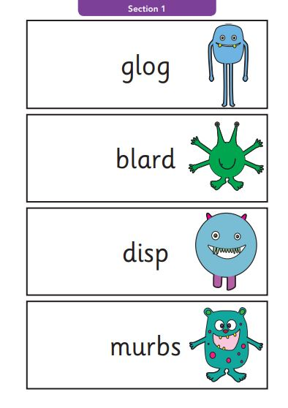
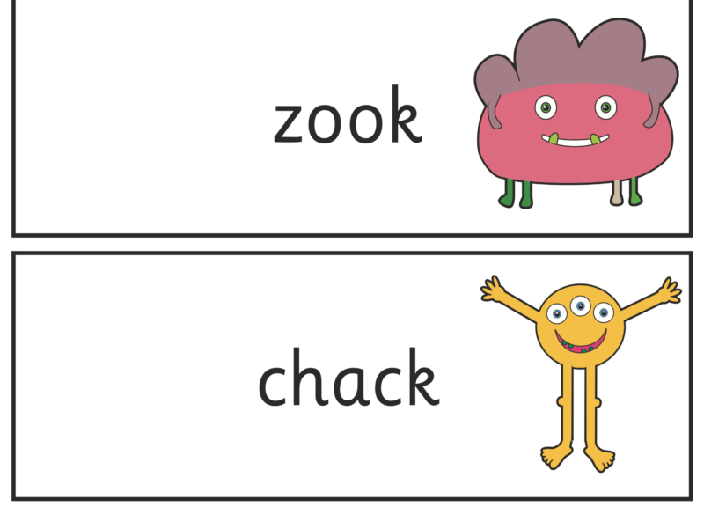
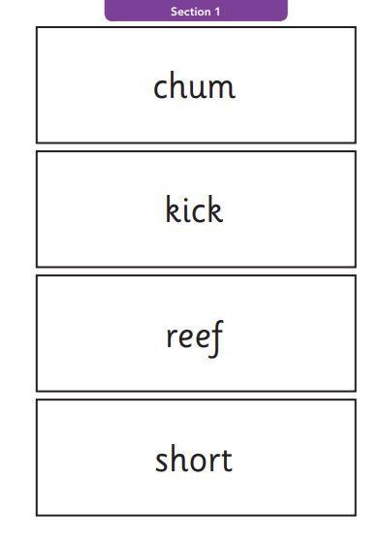
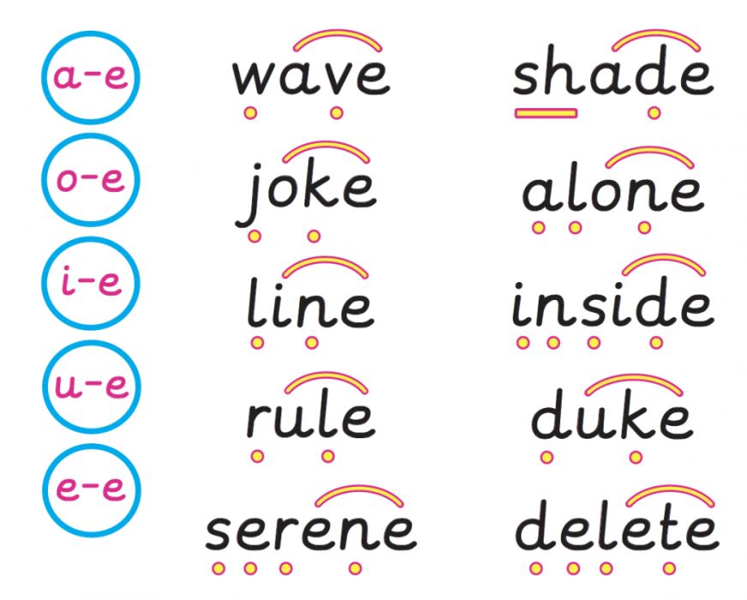
Alien words
Real words

Slide 16
Behaviour and Rewards
Golden Rules – we are gentle, we are kind and helpful, we listen, we are honest, we work hard, we look after property
Values – We have a new value each month. If the children display this value, they get put on the class value tree
We have a behaviour chart. The children are expected to follow the golden rules. If they are not, they receive a reminder, then a warning and then their name is moved to the amber traffic light. Children have an opportunity to get back to the green with good behaviour. If their name is down at the end of a session, they miss a part of the break, lunch or golden time
We have lots of rewards:
Reward Bookmark – Every good lesson is rewarded with a tick. When the bookmark is full, the children get a treat.
WOW wall – amazing work is put on the Wow wall and the children receive an extra tick on their book mark.
Star of the Week and Behaviour Superstar – These are awarded at the end of the week in assembly.
Golden time – The children play for an hour on Friday afternoon as a reward for all their hard work over the week.

Slide 17
Seesaw
This is like Tapestry. It is a way of recording the children’s learning.
We will post pictures and videos of what the children have been learning, if it cannot be placed in a book
We use this as a form of communication between teacher and parent as it has a private messaging option. We can also send class announcements
Please sign up asap

Slide 18
Children need time to adjust to the transition to year 1!
Why?
Long summer holiday
New class
New Teachers
New children to mix with (year 2)
New expectations
More structure to their lessons
Longer periods of focus
We promise we will look after them! They do enjoy maple class and will have lots of fun, but need time to adjust to all the above changes. They will get very tired!

